Slide 1
Revolutionizing Cheque Processing with AI-Powered Efficiency
Team Equators
IntelliCTS

Slide 2
Revolutionizing Cheque Clearing Globally: Empowering Banks with AI/ML for Swift, Secure, and Error-Free Transactions
VISION
To Redefine Banking Efficiency, Processing Millions of Cheques Across Borders with Unmatched Accuracy and Speed

Slide 3
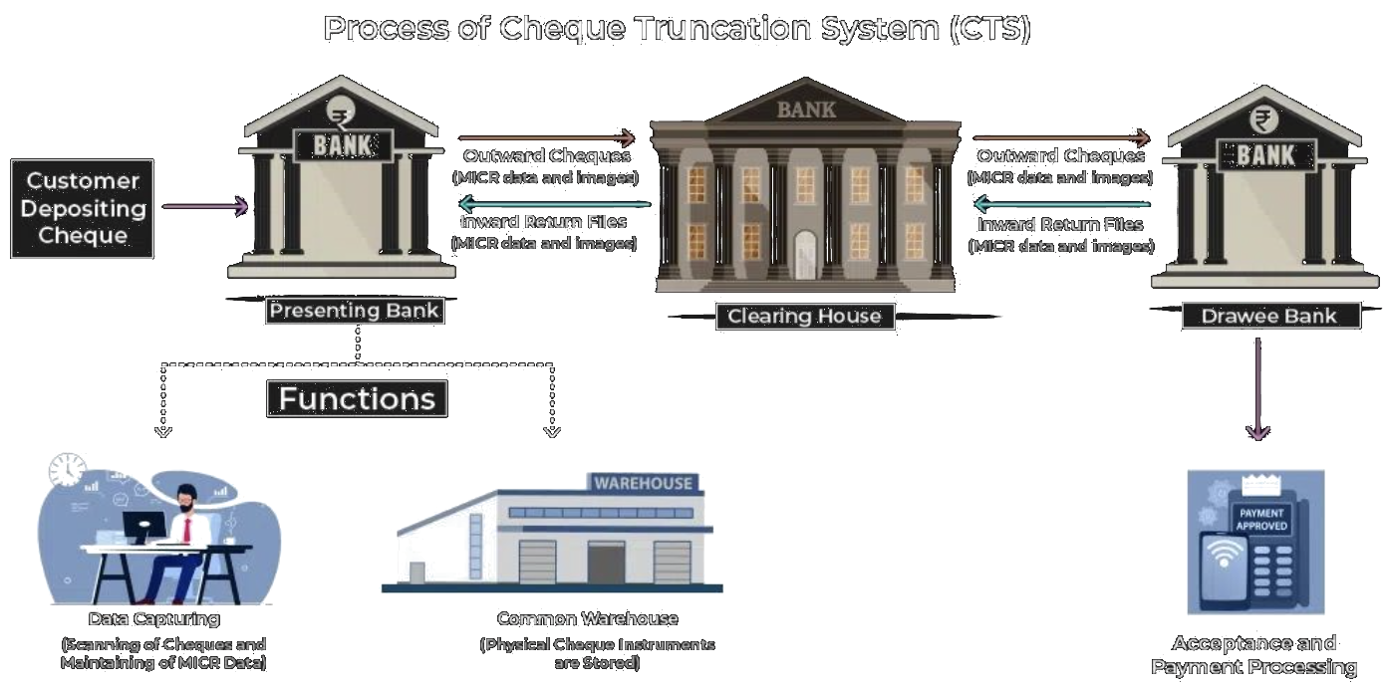
Existing Solution

Slide 4
Manual Verification Processes
The current cheque clearing process involves many manual steps, such as signature verification and technical checks.
These manual processes require high human capital deployment and are time-consuming.
Manual verification processes can lead to errors, delays, and increased operational costs for banks.
Banks need a more efficient and automated solution to streamline the cheque clearing process and reduce reliance on manual intervention.
PROBLEM I

Slide 5
Risk of Fraud and Security Breaches
The current manual and semi-automated cheque clearing processes are susceptible to fraud, including forged signatures and altered cheques.
Lack of robust verification mechanisms can result in fraudulent transactions going undetected.
Security breaches can compromise sensitive customer information and lead to financial losses for banks.
Banks need enhanced security measures and fraud detection mechanisms to mitigate these risks and ensure the integrity of the cheque clearing process.
PROBLEM II

Slide 6
New-Age Banking System For Digitally clearing cheques
Revolutionizing Cheque Clearing with AI/ML and Automation

Slide 7
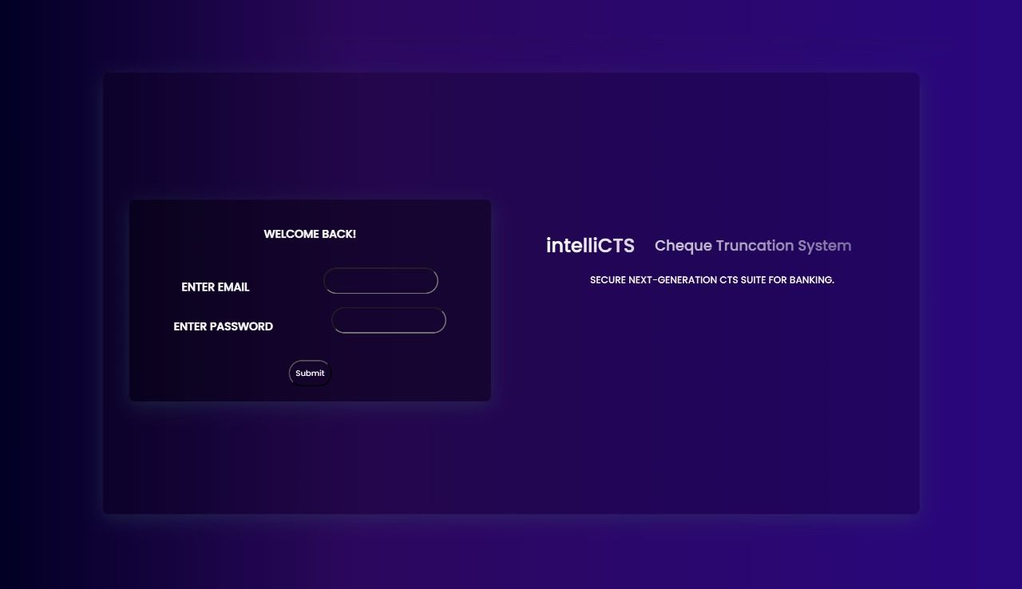
Our Solution
`
IntelliCTS is an innovative Cheque Truncation System that leverages cutting-edge AI/ML/ICR/OCR technologies to revolutionize the cheque clearing process. It automates various tasks such as data entry, technical verification, and signature validation, reducing the need for manual intervention and speeding up processing times. The system is designed to support multilingual capabilities and provides a user-friendly interface for easy navigation.

Slide 8
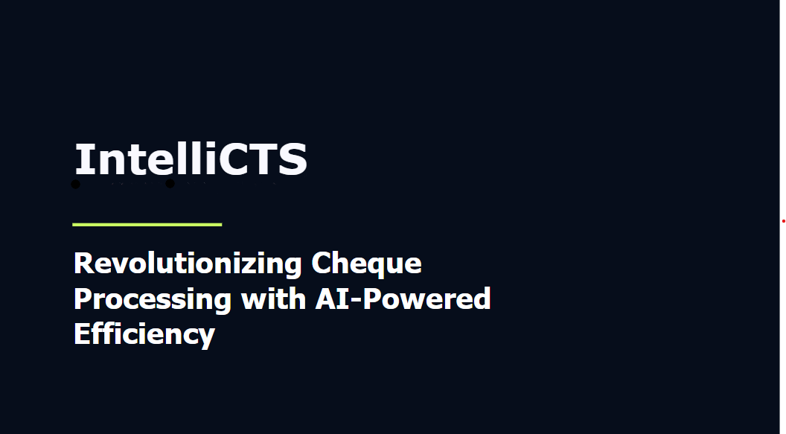
Our Solution
`
Key features of IntelliCTS include:
Automation of the clearing process using AI/ML/ICR/OCR techniques
Automatic data entry and technical verification
Signature verification
Multilingual support
Reduction of human efforts and processing time
Detection of potential frauds

Slide 9
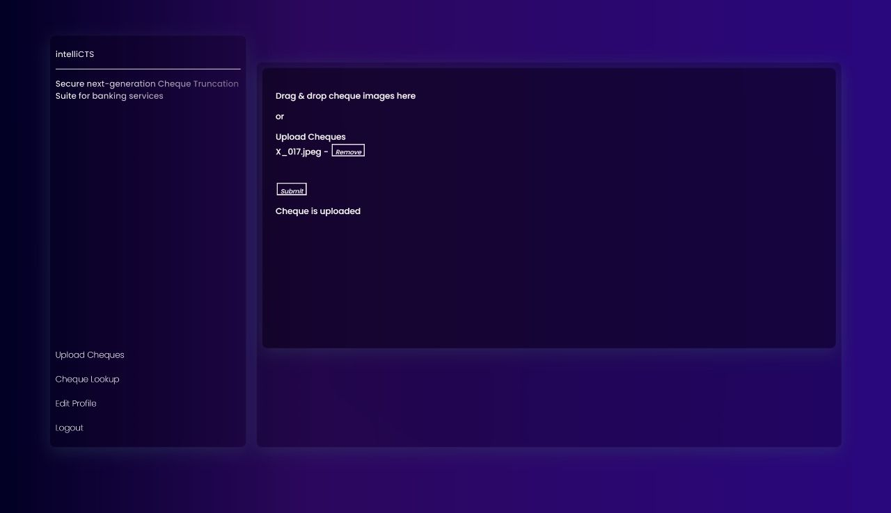
Our Solution
`

Slide 10
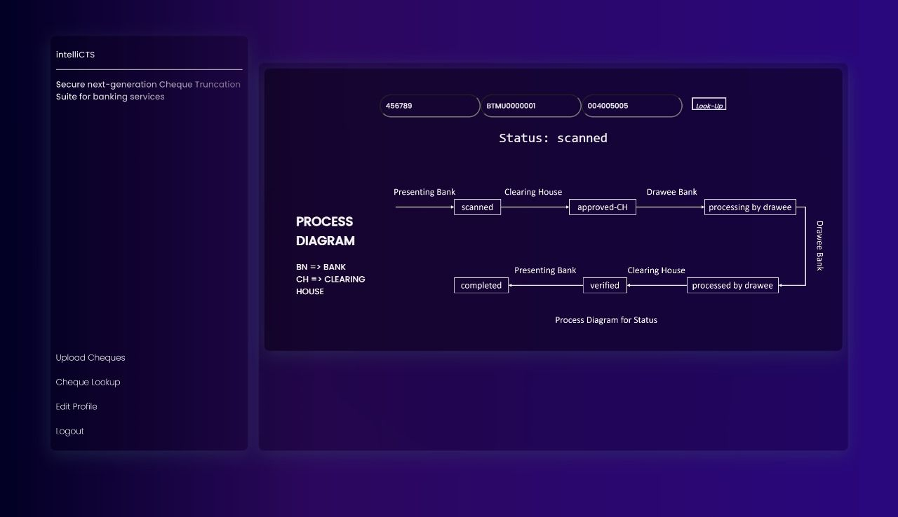
Our Solution
`

Slide 11










TechStack Used
Technologies

Slide 12
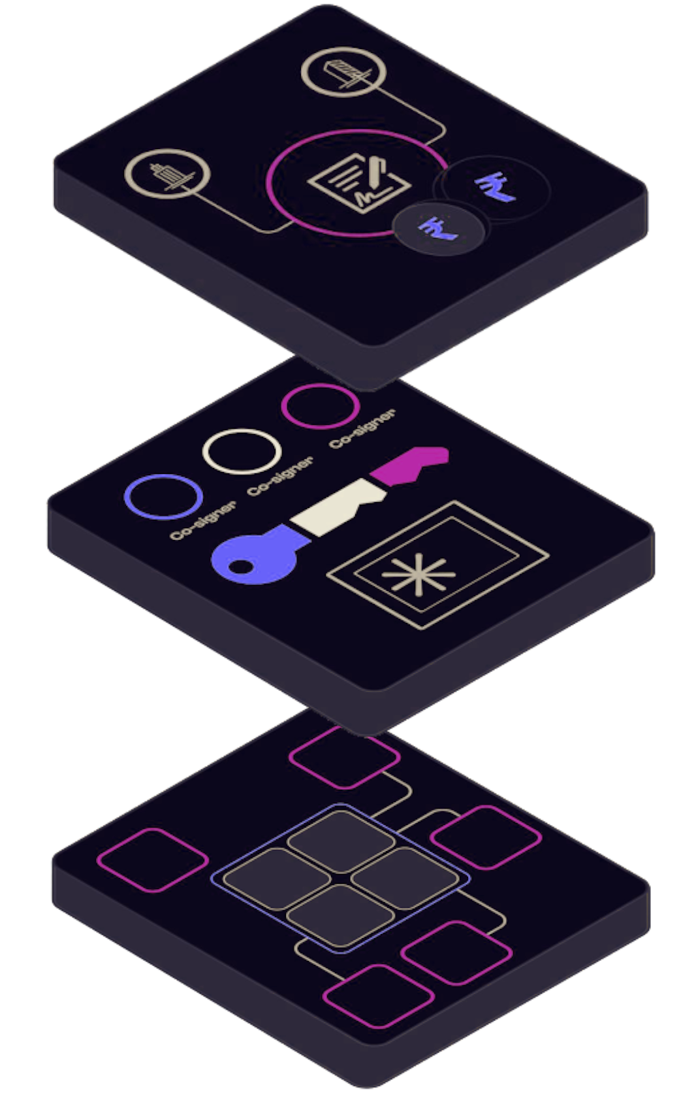
TechStack Used
Tools used
High-performance cloud computing resources (e.g., AWS, Azure) for data processing and machine learning model training
APIs for integrating fraudulent registration and facial recognition systems
Jupyter Notebooks or Kaggle Notebooks for coding and collaboration
Kaggle for accessing datasets and potentially executing code
Bootstrap (for user interface design)

Slide 13
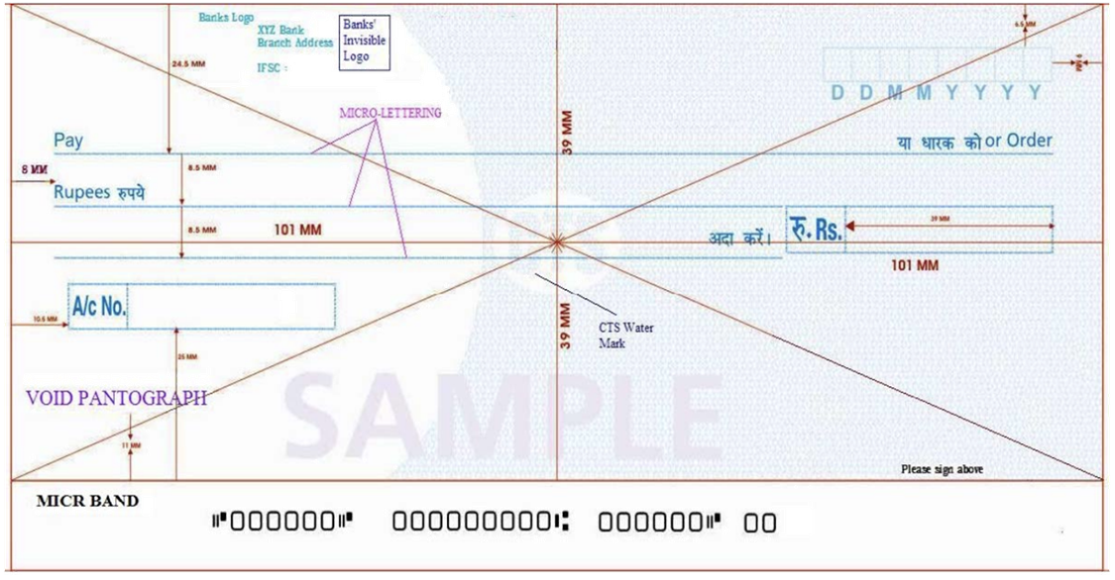
Cheque Data Segmentation
Sample Cheque
from RBI-CTS2010 Standards

Slide 14
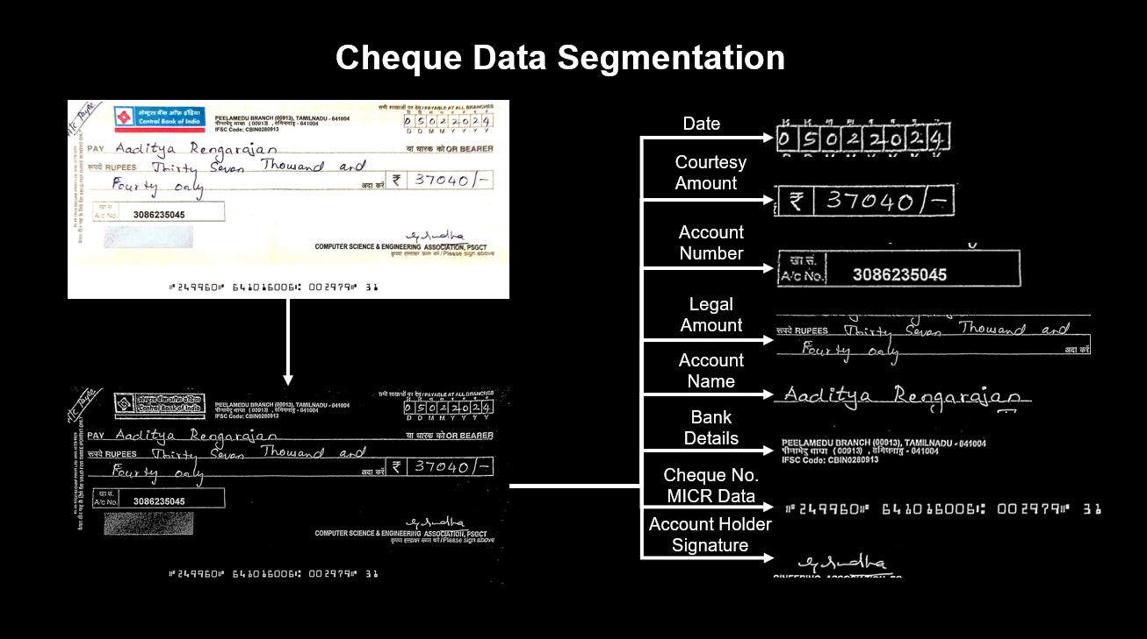

Slide 15
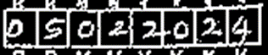

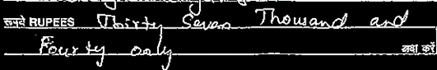

Anti-Fraud Systems
Date Verification: Compare current date to Cheque Date.
Amount Tampering Verification: Compare Legal Amount to Courtesy Amount.
Signature Verification: Ensure Signature matches known records.

Slide 16
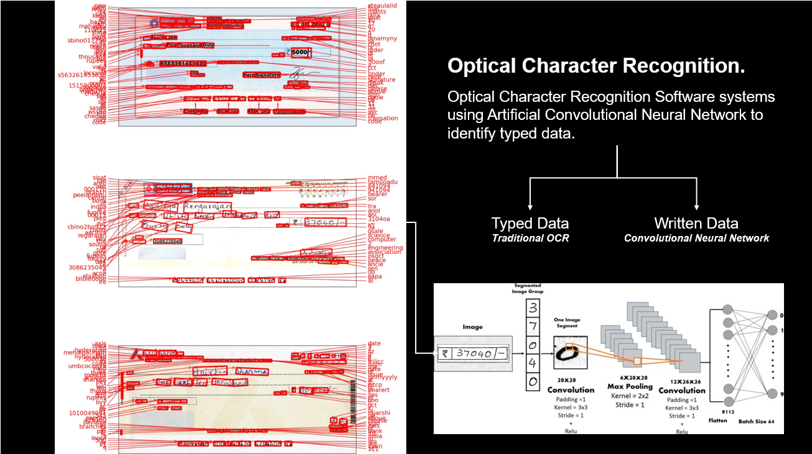

Slide 17
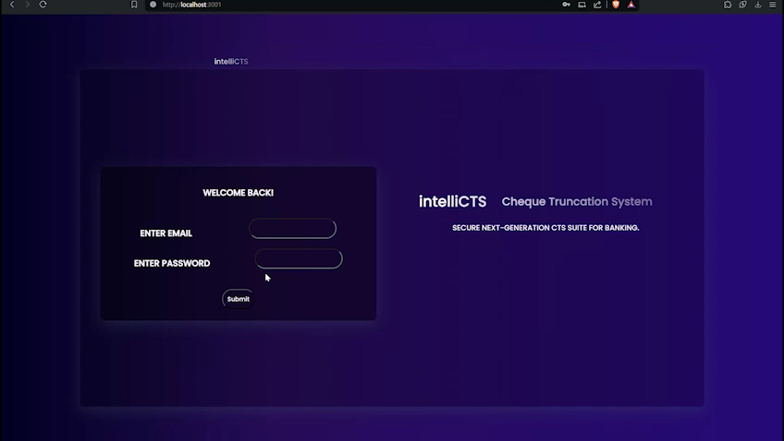
Interface Demo

Slide 18
Cheque Parsing Demo

Slide 19
Unique Selling Propositions
Blockchain
In IntelliCTS, we utilize blockchain technology to digitally clear cheques, enhancing the efficiency and security of the clearing process. Here's how we leverage blockchain for digital cheque clearing
Data Integrity
Immutable Record-Keeping
Enhanced Security
Efficient, secure, and transparent process, benefiting both financial institutions and customers.
Notes:
Proof of Work (PoW) and Proof of Stake (PoS) are consensus algorithms used in blockchain networks to achieve agreement on the state of the blockchain. Here's a brief explanation of each:
Proof of Work (PoW): PoW is a consensus algorithm where miners compete to solve complex mathematical puzzles to validate transactions and create new blocks. The first miner to solve the puzzle broadcasts the new block to the network, and other nodes verify the solution. PoW is known for its security and decentralization but requires a significant amount of computational power and energy.
Proof of Stake (PoS): PoS is a consensus algorithm where validators are chosen to create new blocks based on the number of coins they hold or "stake." In PoS, validators are selected in a deterministic manner, and the chances of being chosen to create a new block are proportional to their stake. PoS is more energy-efficient than PoW but still ensures security and decentralization.
In the context of blockchain implementation for IntelliCTS, mentioning PoW or PoS highlights the method by which consensus is achieved, ensuring the security and integrity of transaction processing.

Slide 20
Unique Selling Propositions
Zero Knowledge Proof
In IntelliCTS, we implement Zero Knowledge Proof (ZKP) to enhance the security and confidentiality of cheque transactions. Here's how we leverage ZKP for cheque processing
Confidential Transaction Verification
Data Privacy
Secure Authentication
Improved Trust and Transparency
Fraud Prevention
By integrating Zero Knowledge Proof into IntelliCTS, we ensure that cheque transactions are processed securely, confidentially, and efficiently, providing a high level of security and trust for financial institutions and customers alike.
Notes:
Proof of Work (PoW) and Proof of Stake (PoS) are consensus algorithms used in blockchain networks to achieve agreement on the state of the blockchain. Here's a brief explanation of each:
Proof of Work (PoW): PoW is a consensus algorithm where miners compete to solve complex mathematical puzzles to validate transactions and create new blocks. The first miner to solve the puzzle broadcasts the new block to the network, and other nodes verify the solution. PoW is known for its security and decentralization but requires a significant amount of computational power and energy.
Proof of Stake (PoS): PoS is a consensus algorithm where validators are chosen to create new blocks based on the number of coins they hold or "stake." In PoS, validators are selected in a deterministic manner, and the chances of being chosen to create a new block are proportional to their stake. PoS is more energy-efficient than PoW but still ensures security and decentralization.
In the context of blockchain implementation for IntelliCTS, mentioning PoW or PoS highlights the method by which consensus is achieved, ensuring the security and integrity of transaction processing.

Slide 21

GO-TO-MARKET
Target Markets
Primary - India
Secondary - UAE
Penetration Strategy
Digital Cheque Clearing Solution
Showcase the efficiency, security, and compliance benefits of digital clearing of cheques, offering tailored solutions for commercial banks to drive adoption and establish strategic partnerships.
Channel Partners
Banking Consortiums
Partner with banking consortiums to become their tech provider.
SaaS Model
Offer platform to banks as Saas.
Scale

Slide 22

BUSINESS MODEL
Financial Product
SaaS
Transaction Fee
Licencing Fee
Support Fee

Slide 23

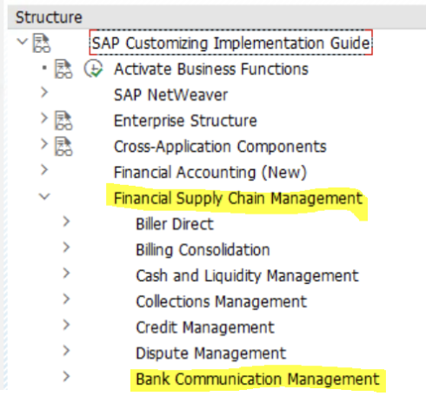
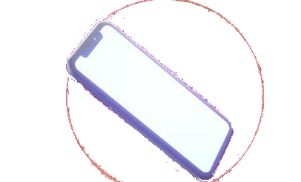
FUTURE SCOPE
Integrations
SAP -> FSCM (Financial Supply Chain Management)>BCM (Bank Communication Management)
Efficiency Enhancement
Integration with Digital Channels - Offer customers the convenience of initiating cheque deposits remotely through mobile or online platforms.

Slide 24
Thank You!
Team Equators

